Slide 1

BART RIDERSHIP PREDICTIONS: Machine learning models
2019.07.31
Charlene LEONG
Jane kim
Kelli Okuji Wilson
Ratan HODAR
Rein John D. Grona

Slide 2
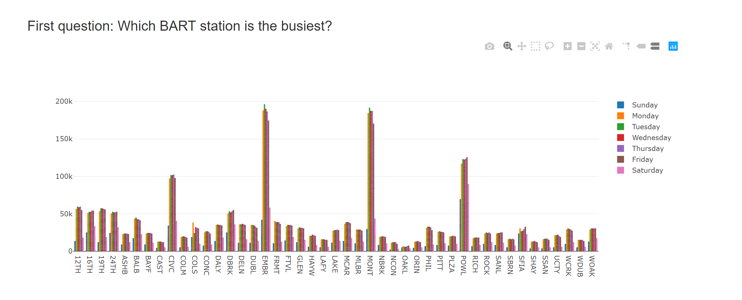
BACKGROUND
Expansion of our previous project…

Slide 3
BACKGROUND
How about “when”?
“When would be the busiest time to ride BART?”

Slide 4
Scope & Problem statement
Problem statement
When is the busiest time (date and hour) to take BART from selected BART stations (EMBR SFO, COLS)?
Goal
Based on historical BART ridership data, predict number of passengers (daily and hourly trend)
Scope
Dataset : BART ridership hourly data (January 1, ~May 31, 2017)
Value : Sum of passengers from “origin” station (regardless of destination)
Selected stations :
Embarcadero (busiest station) – 1 from downtown SF
SFO (random station where it would not have any impact from commuters but impact from visitors) – 1 from Peninsula
Coliseum (another random station w/o impact from commuters but with impact from events) – 1 from Eastbay

Slide 5
METHODS
ARIMA (Autoregressive Integrated Moving Average)
Facebook Prophet
LSTM (Long Short-Term Memory)

Slide 6
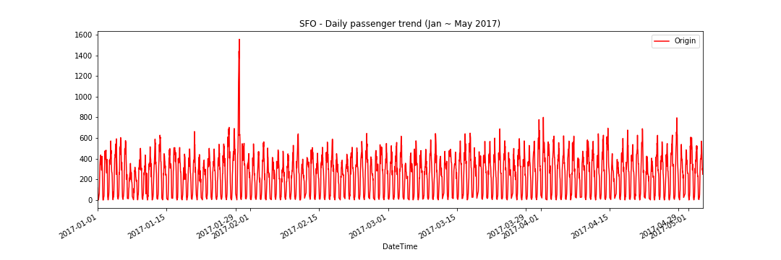
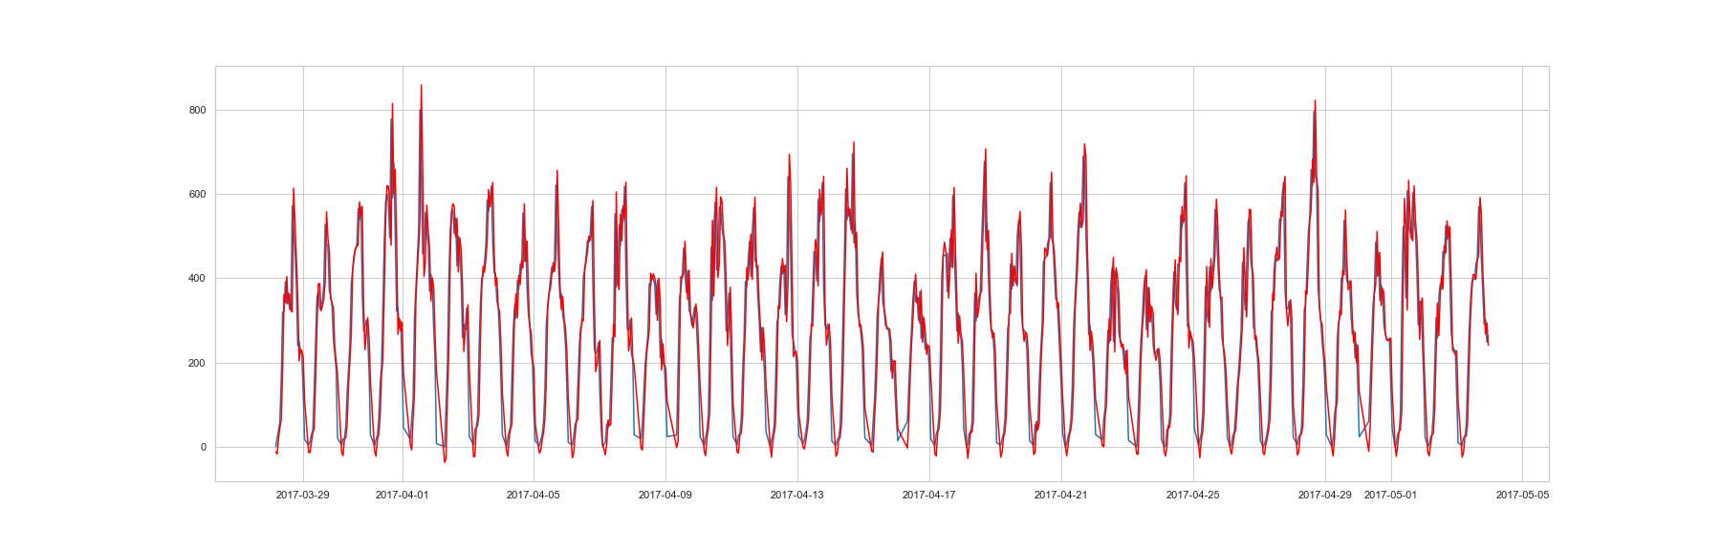
ARIMA prediction - SFO
model = ARIMA(history, order=(2,1,0))
SFO – MSE: 9420.969

Slide 7
Facebook prophet
Historically used in advertising to capture seasonal trends
Results conveyed probability that the mean will fall within a certain range (specified 95% confidence interval)
Limited by our own data – the model is intended to capture seasonal trends, yet we only have 1.5 years of hourly data
Data skewed by outliers - Did not remove holidays, which could affect how the model is trained

Slide 8
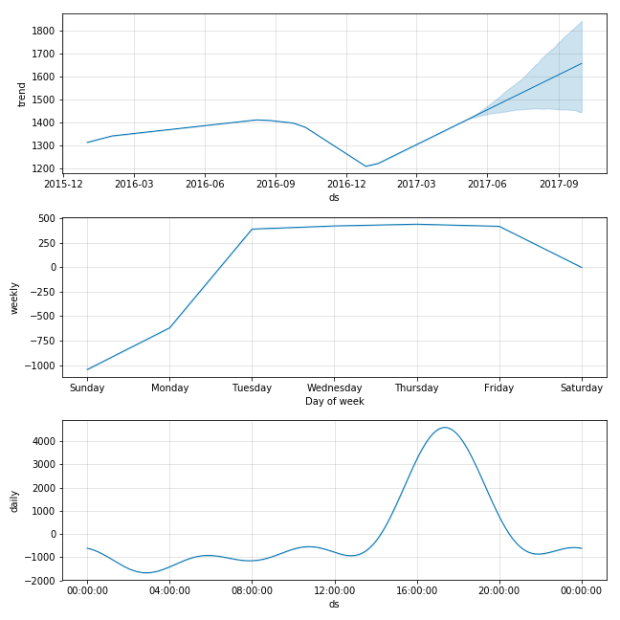
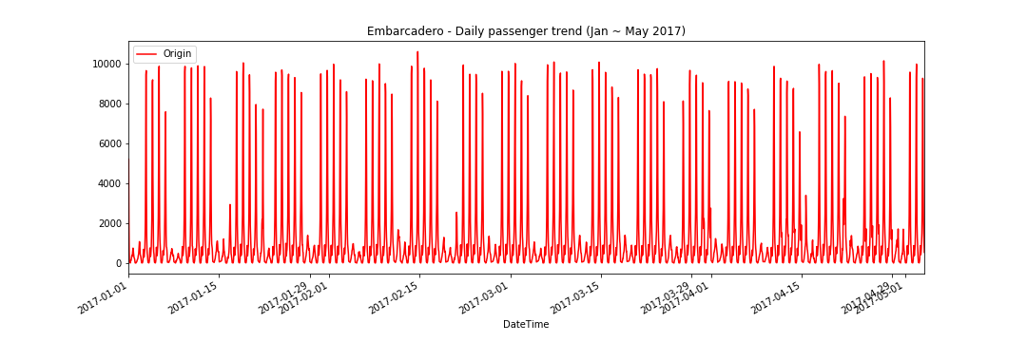
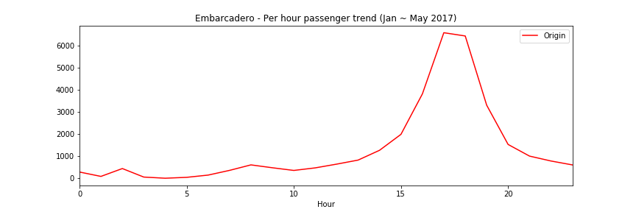
FB PROphet Prediction : Embarcadero
Embarcadero

Slide 9
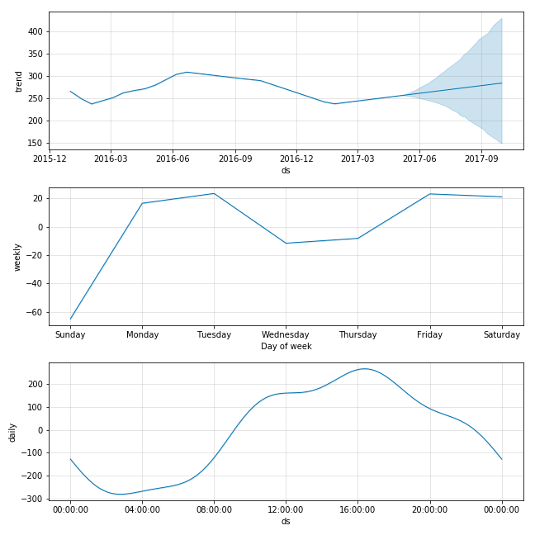
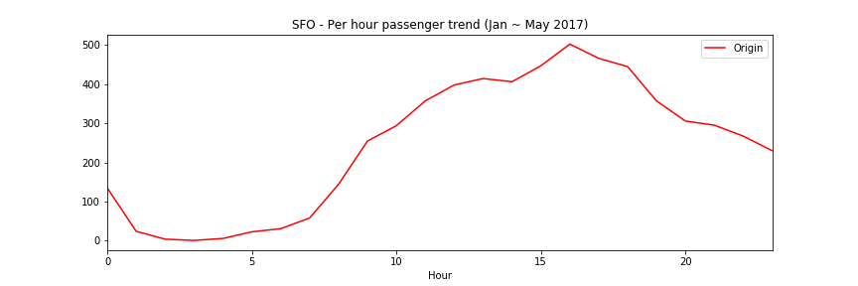
FB PROphet Prediction : SFO
SFO

Slide 10
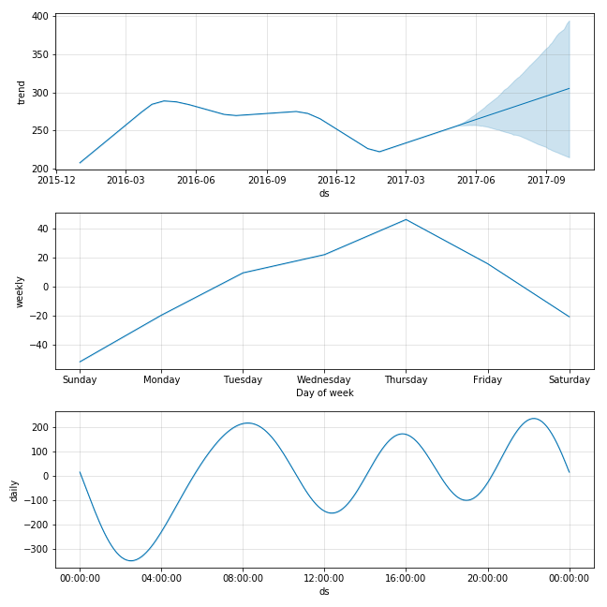
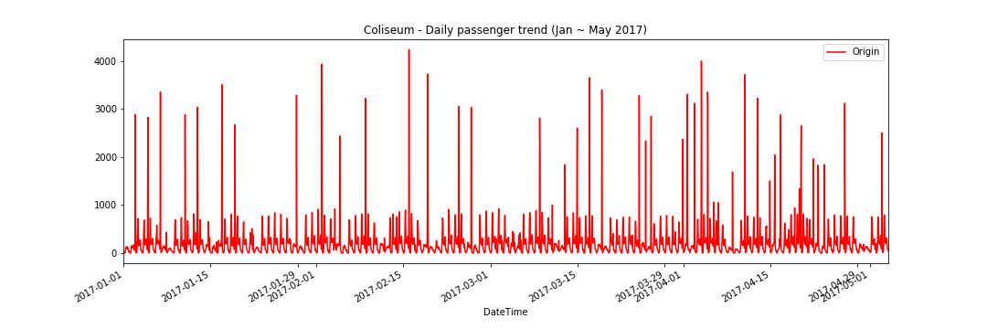
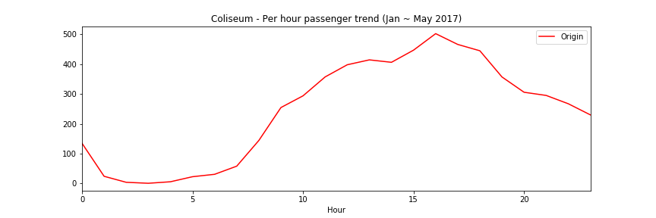
FB PROphet Prediction : COliseum
Coliseum

Slide 11
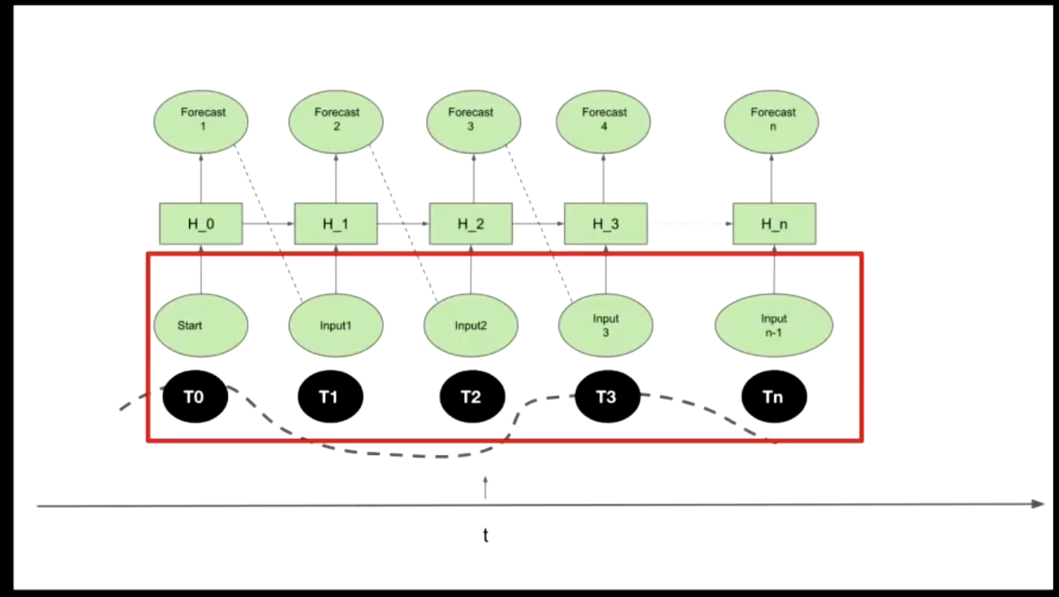
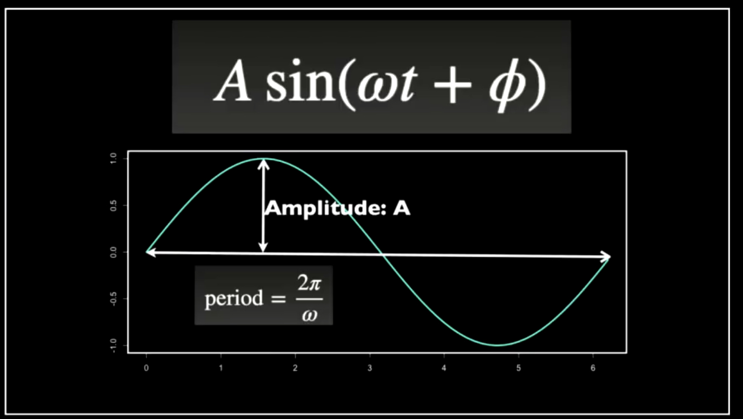
Lstm (Long short-term memory)
Recurrent Neural Network (RNN)
Inputs, Hidden layers, Forecasts are used to create output.
Time series is somewhat like sine functions.
Uses multiple layers for forecasting.

Slide 12
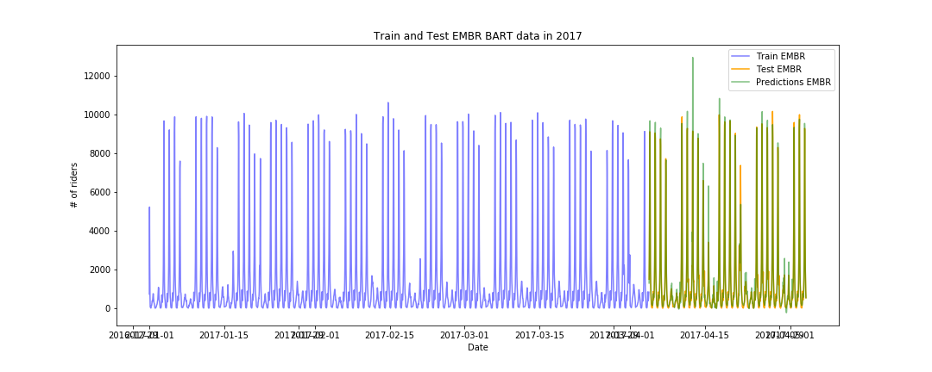
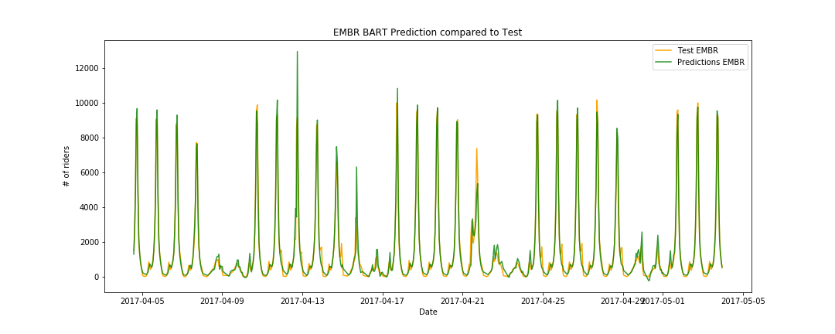
LSTM Prediction : Embarcadero
Embarcadero
EPOCHS = 100 | BATCH SIZE = 60 | MSE = .0018

Slide 13
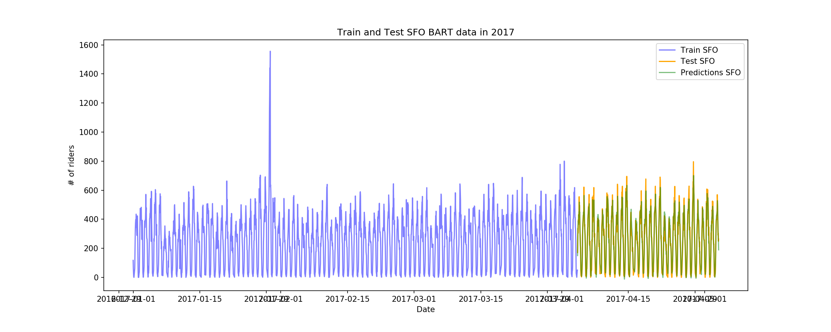
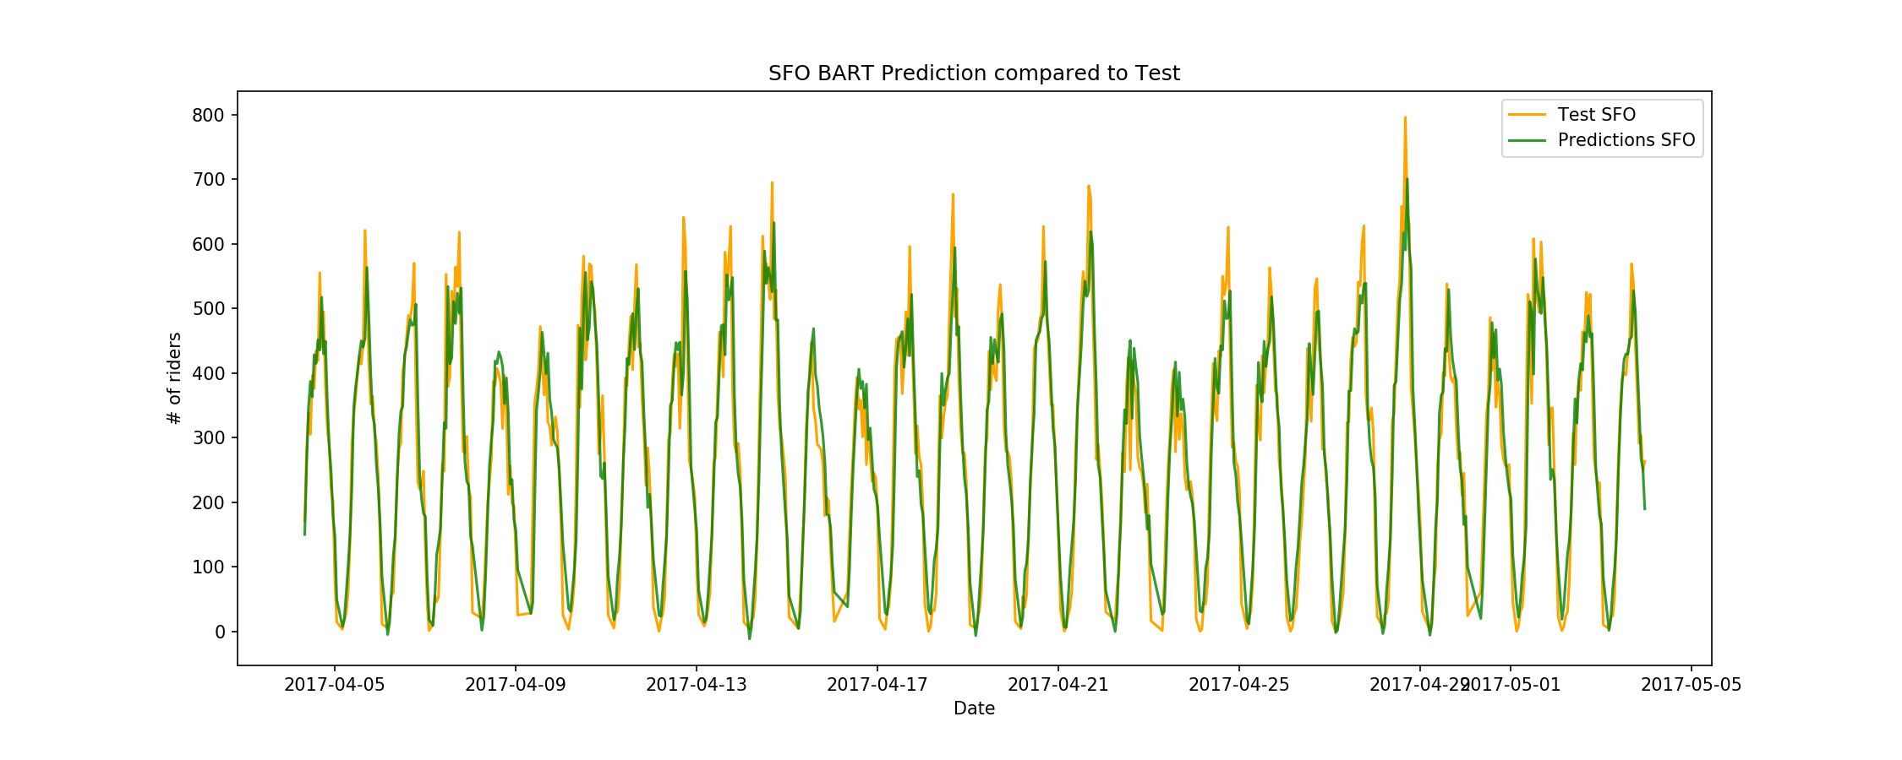
LSTM Prediction : Daily - SFO
SFO
EPOCHS = 100 | BATCH SIZE = 60 | MSE = .0018

Slide 14
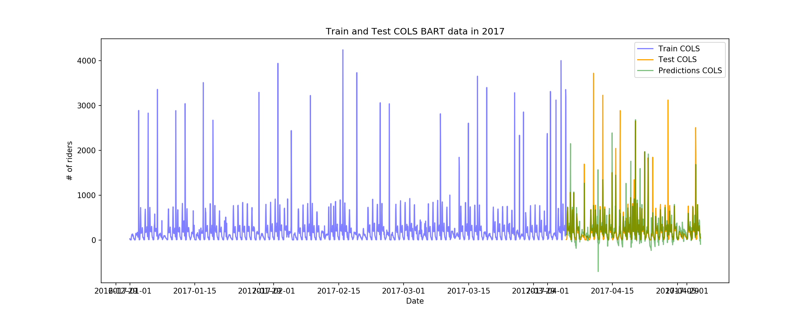
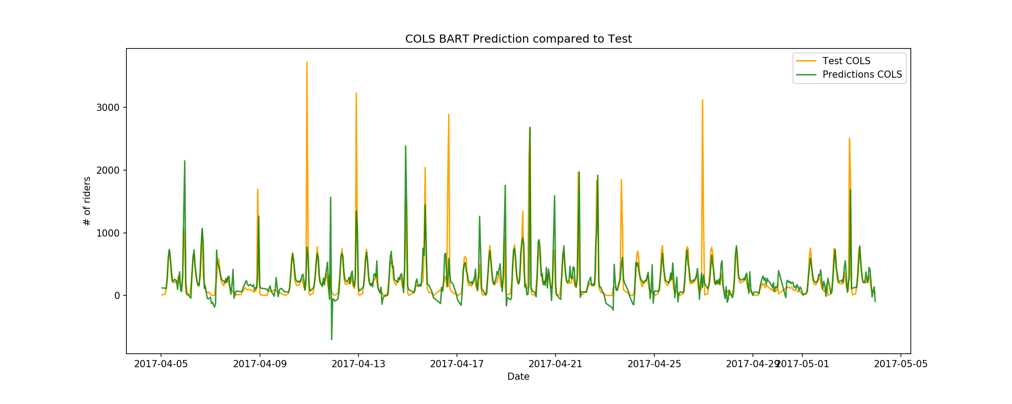
LSTM Prediction : Coliseum
Coliseum
EPOCHS = 100 | BATCH SIZE = 60 | MSE = .0049

Slide 15
CONCLUSIONS
Not one model fits all
Tuning the model is important
In our case, LSTM was the best model
Use various means such as epochs, hidden layers, batch size, and dropouts to yield better results
Many time series machine learning models are available, but the LSTM model provided the best prediction result due to the cyclical nature of the data
LSTM was ideal for our time series predictions since it is based on a series of prior data sequences to predict future outcomes
LSTM are able to store past information that is important, forget the information that is not, and pass through the best output based on weighted inputs

Slide 16
LESSONS LEARNED
Problem statement
Approach
Method
Develop a deep understanding of model fundamentals – may require experience in advanced level mathematics, computer science
Define a strong problem statement upfront (can represent a “point of no return” in later project stages)
Experiment with several models to devise the best outcome for your problem statement

